Slide 1
hackMGM
Using Git & GitHub, Aug 17, 2017

Slide 2
Jacqueline “Jacquie” McKinney
Tuskegee Graduate – BS in Computer Science
WPI Graduate – MS in Systems Engineering
Software Engineer/13 years
Worked at Xerox, CACI, Raytheon, GDIT (present)
Worked with C, C++, CORBA, PHP, Perl, Python, HTML/CSS, JS, bash
Not so much with Java, TCL/Tk, MS Visual C++, MS COMM
Linux/UNIX
From Montgomery, AL
Soul Searching
Learning Django and WordPress frameworks

Slide 3
Agenda
What is Git
What is GitHub
Working in GitHutb - Markdown
Working with Git
Working in GitHub – Issues
Git Workflow
Exercise

Slide 4
Handouts
git cheat sheet
http://rogerdudler.github.io/git-guide/files/git_cheat_sheet.pdf
Mastering Markdown
https://guides.github.com/features/mastering-markdown/
Hello World
https://guides.github.com/activities/hello-world/
Forking a Repo
https://guides.github.com/activities/forking/

Slide 5
What is Git?
Configuration Management

Slide 6
Git
By far, the most widely used modern version control system in the world today is Git. Git is a mature, actively maintained open source project originally developed in 2005 by Linus Torvalds, the famous creator of the Linux operating system kernel. A staggering number of software projects rely on Git for version control, including commercial projects as well as open source.
Has a distributed architecture, called DVCS (distributed version control system)
Every Git directory on every computer is a full-fledged repository with complete history and full version tracking abilities, independent of network access or a central server

Slide 7
What is GitHub?
Configuration Management

Slide 8
GitHub
A web-based Git or version control repository and Internet hosting service. It is mostly used for code. It offers all of the distributed version control and source code management (SCM) functionality of Git as well as adding its own features.
The flagship functionality of GitHub is “forking” – copying a repository from one user’s account to another. This enables you to take a project that you don’t have write access to and modify it under your own account. If you make changes you’d like to share, you can send a notification called a “pull request” to the original owner. That user can then, with a click of a button, merge the changes found in your repo with the original repo
These three features – fork, pull request and merge – are what make GitHub so powerful.
Integrated free wiki
Simple Markdown pages for notes and general documentation
Integrated free issue tracker
Easy Collaboration

Slide 9
GitHub Guides
https://guides.github.com/
3 – 15 minutes guides
The basics

Slide 10
Working in GitHub
Markdown

Slide 11
Markdown
https://guides.github.com/features/mastering-markdown/
https://help.github.com/articles/basic-writing-and-formatting-syntax/
Let’s go to GitHub and look at the editor
Gists
Comments
Issues
.md and .markdown files
Wiki
GitHub not just for source code
Someone is using it to ask for help with travel arrangements
https://github.com/dylanegan/travel
Notes:
This is by no means implying that open source is hobby software

Slide 12
Working with Git
Configuration Management

Slide 13
Git – Distributed Repository
https://softwareengineering.stackexchange.com/a/35080
Notes:
Answer on SE that talks about all of the pros of a distributed environment.
As well as a cheat sheet to best practices that one person or a team should adopt with some pictures showing centralized vs distributed

Slide 14
Git
Interactive online tutorial
http://try.github.io/
http://onlywei.github.io/explain-git-with-d3/
Visual Reference
https://marklodato.github.io/visual-git-guide/index-en.html
References
http://rogerdudler.github.io/git-guide/
https://git-scm.com/docs
Notes:
This is by no means implying that open source is hobby software

Slide 15

Git – Master
Notes:
This is by no means implying that open source is hobby software

Slide 16
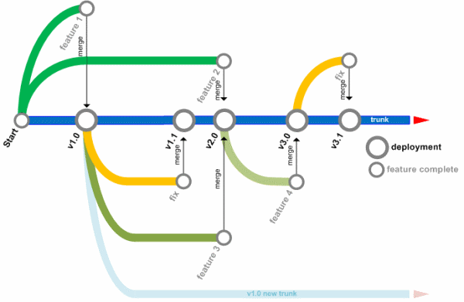
Git – Branch / Tag / Commit
Notes:
This is by no means implying that open source is hobby software

Slide 17
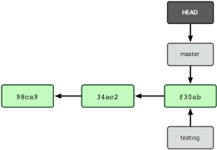
Git – HEAD
Notes:
This is by no means implying that open source is hobby software

Slide 18
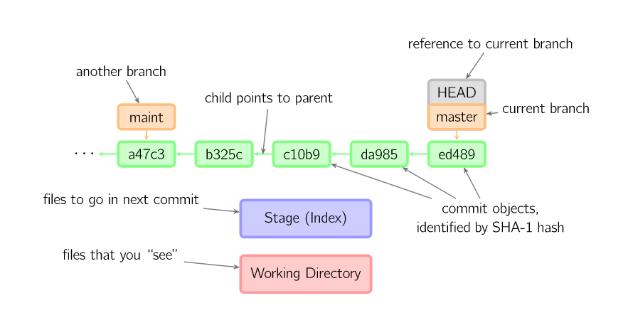
Git – HEAD
Notes:
This is by no means implying that open source is hobby software

Slide 19
Git – HEAD
Notes:
This is by no means implying that open source is hobby software

Slide 20
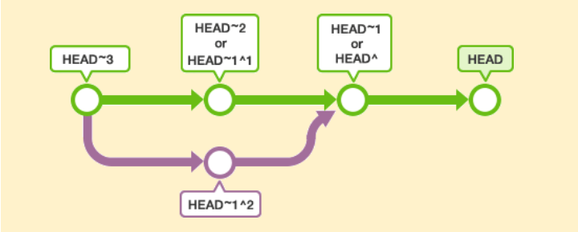
Git – HEAD (Advanced)
The ~(tilde) and ^(caret) symbols are used to point to a position relative to a specific commit. The symbols are used together with a commit reference, typically HEAD or a commit hash.
For instance, ~<n> refers to the <n>th grandparent. HEAD~1 refers to the commit's first parent. HEAD~2 refers to the first parent of the commit's first parent.
^<n> refers to the the <n>th parent. HEAD^1 refers to the commit's first parent. HEAD^2 refers to the commit's second parent. A commit can have two parents in a merge commit.
Notes:
This is by no means implying that open source is hobby software

Slide 21
The Basics of Git and GitHub
https://www.youtube.com/watch?v=U8GBXvdmHT4&t=566s
Notes:
This is by no means implying that open source is hobby software

Slide 22
Working in GitHub
Issues

Slide 23
GitHub Issues
https://guides.github.com/features/issues/

Slide 24
GitHub Closing Issues
Closing a pull request, using the following comments:
The following keywords, followed by an issue number, will close the issue:
close
closes
closed
fix
fixes
fixed
resolve
resolves
resolved

Slide 25
Forking & Feature Workflow
Configuration Management

Slide 26
Feature & Forking Workflow
Feature Workflow
https://www.atlassian.com/git/tutorials/comparing-workflows#feature-branch-workflow
Forking Workflow
https://www.atlassian.com/git/tutorials/comparing-workflows#forking-workflow
hackMGM Workflow
Recommend a combination of Forking + Feature Workflow
This is a common workflow
Do not specifically recommend develop, production/release type of branching
Anything on Master is deployed
https://github.com/HackMGM/hackmgm-notes/blob/master/process/hackmgm_git_workflow.md
https://gist.github.com/Chaser324/ce0505fbed06b947d962

Slide 27
GitHub - Projects
Configuration Management

Slide 28
Projects
GitHub Projects
1 minute video on GitHub Projects
This is a Kanban style board to help manage your projects (think Trello)
https://www.youtube.com/watch?v=C6MGKHkNtxU

Slide 29
Git/GitHub Install
Configuration Management

Slide 30
Git/GitHub Install
Git for Windows (git bash & GUI)
https://git-for-windows.github.io/
Windows and Others (GUI)
https://www.sourcetreeapp.com/
https://desktop.github.com/
Git
https://gist.github.com/derhuerst/1b15ff4652a867391f03
https://git-scm.com/book/en/v2/Getting-Started-Installing-Git

Slide 31
Git/GitHub Install
Sourcetree App terminal access
https://confluence.atlassian.com/sourcetreekb/using-terminal-in-sourcetree-781398580.html
GitHub Desktop terminal access
https://saraford.net/2017/02/08/how-to-use-your-preferred-command-line-interface-from-github-desktop-039/

Slide 32
Exercise

Slide 33
Exercise
https://guides.github.com/activities/hello-world/
https://github.com/HackMGM/hackmgm-profiles
If you are not doing the exercise I recommend doing
http://try.github.io/
Notes:
This is by no means implying that open source is hobby software

Slide 34
Additional Resources

Slide 35
Resources
Git Rebase
??
Git Merge Conflict
https://confluence.atlassian.com/bitbucket/resolve-merge-conflicts-704414003.html
GitHub Videos
https://www.youtube.com/githubguides
Git graphs
https://stackoverflow.com/questions/1057564/pretty-git-branch-graphs
Notes:
This is by no means implying that open source is hobby software

Slide 36
Questions?

Slide 37
Get to hackin’!

Slide 38
Extras

Slide 39
Agenda
What is CM
Concepts & Terminology
Working in GitHutb - Markdown
Working with Git
Working in GitHub – Issues
Git Workflow
Exercise

Slide 40
What is CM?
Configuration Management

Slide 41
Configuration Management or Source Code Management
The purpose of Software Configuration Management is to establish and maintain the integrity of the products of the software project throughout the project's software life cycle. Software Configuration Management involves identifying configuration items for the software project, controlling these configuration items and changes to them, and recording and reporting status and change activity for these configuration items [SEI 2000a].

Slide 42
Concepts & Terminology
Configuration Management

Slide 43
CM
Defined process to control and track what’s going on throughout the lifecycle (different phases) of a project
Configuration Item (CI)
Hardware
Software
Document (word doc, ppt, excel)
(Anything involved with the delivery of software or hardware)
Control and manage change (identify, schedule, accept, and reject changes)
Change Control Board (CCB)
Tool – issue tracker
Track those changes (what version of a CI is associated with what release)
Tool – GitHub or some other type of CM software
Notes:
CCB’s can assign priority to issues, decide not to fix issues, make sure it’s in the scope of work agreed to (this is important), decide to fix an issue, what version of release will this change be made available.
Different CCB handle different parts of a program, e.g. requirements

Slide 44
Why do you need CM?

Slide 45
CM
Readily identify what functionality, bugs, changes, or fixes that were handled
Identify what version of the software is at the different phases of your project
Development
Production
Currently being fixed (Maintenance)
What software is problematic
Rollback to a previous version of working software
Connects to another part of software engineering called Requirements Management
Allows you to trace what requirement was implemented by identifying the software that implemented it
Or the reverse, revisit a requirement based on the software not functioning as expected (Was this a good requirement, does it need to be re-written)
Notes:
- Version, baseline, or release of software
- Requirements can be mapped down to the exact line of code, the function, class, or the module/component depending on the scale and intensity of your program $$$$$

Slide 46
CM
Facilitates COLLABORATION
Identifying who made the changes
Merging in changes if multiple people edited the same file
Everyone (that needs to) has access to the files
It’s not just sitting on Paul’s computer who just won the lottery and isn’t returning back to work tomorrow
CONTINUITY

Slide 47
Open Source/Hobby Software
Even in Open Source or Hobby Software, you want to be able to list the functionality and changes associated with a release.
You could just use a word document, but if you needed to rollback your software a word document isn’t going to help you.
View a changelog
Notes:
This is by no means implying that open source is hobby software
You could also color code items or find some naming convention, what if you shared this document with someone and they made changes, how do you merge the information if needed. How do you sort items (I guess you could go to a spreadsheet for that)

Slide 48
Terminology
Baseline | Lock
Release | Reserve vs Unreserve checkout
Branch | Forking
Stream | Repository
Tag | Snapshot
Label | HEAD
Commit | Clean
Checkin | Dirty
Push | Stash
Merge | Workspace
Checkout | View
Pull
Notes:
This is by no means implying that open source is hobby software

Slide 49
Free SCMs
Concurrent Versions System (CVS)
Revision Control System (RCS)
Source Code Control System (SCCS)
Git (GitHub, BitBucket)
Mercurial (Heroku)
Subversion (SVN)
Notes:
This is by no means implying that open source is hobby software

Slide 50
Commercial SCMs
PVCS
IBM Rational Clear Case
IBM RTC
Notes:
This is by no means implying that open source is hobby software

Slide 51
Working with Git
Configuration Management

Slide 52
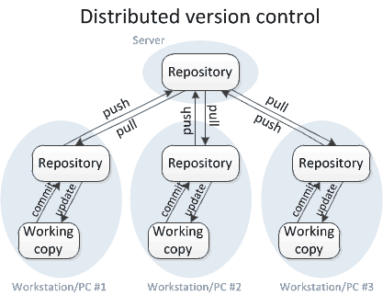
Git – Distributed Repository

Slide 53
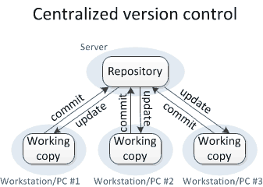
(Git is not) Centralized Repository

Slide 54
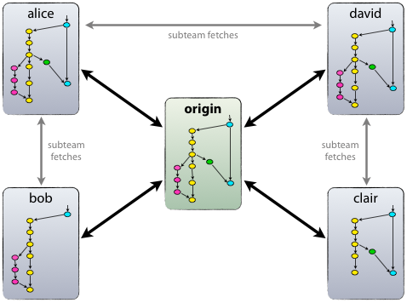
Git – Distributed Repository

Slide 55
